Slide 1

Grow with Oppulent grove
Eshaan Kumar
& Abhay Singh

Slide 2
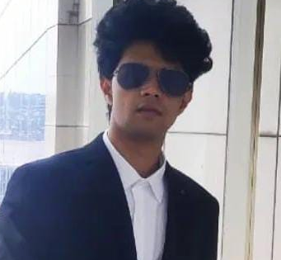
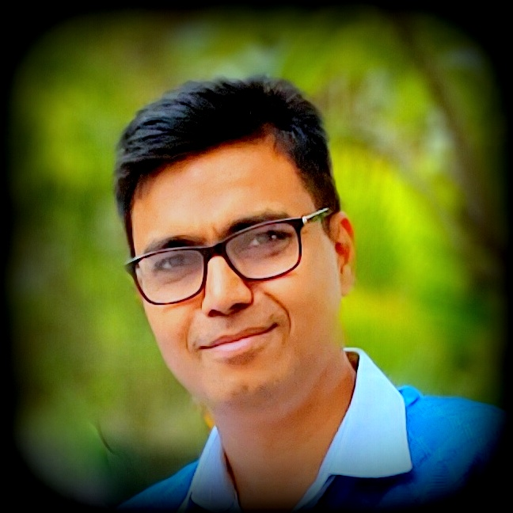
MEET OUR TEAM
Eshaan Kumar
Abhay Singh
Director-Operations
IIT Roorkee, 23 Years IT Experience
Director-Strategy
NISM Certified Research Analyst
AMFI Registered Financial Advisor
APMI Registered PMS Advisor

Slide 3

WHY ELIXIR – Our CREDENTIALS-Strategy & Operations
NISM-Series-VIII: Equity Derivatives
NISM-Series-V-A: Mutual Fund Distributors & NISM-Series-V-B: Mutual Fund Foundation
NISM-Series-XVIII: Financial Education & NISM-Series-XII: Securities Markets Foundation
NISM-Series-ll-B: Registrars to an Issue and Share Transfer Agents - Mutual Fund
NISM-Series-VII: Securities Operations and Risk Management
Authorized Financial adviser - ARN-282569 – AMFI ; EUIN-E532622
SEBI Certified Research Analyst -2410061666
Operations Team head is associated with many organizations in senior positions, Delivered multi million-dollar finance projects across multiple technologies
Developed multiple tools in Python. Extensively used Excel. Expertise in algorithm related to derivative market

Slide 4
WHY ELIXIR – Our CREDENTIALS-Strategy & Operations
NISM XXI-A PMS DISTRIBUTORS
Registered PMS advisor- APRN-00187 -APMI
SEBI Certified Research Analyst -2410061666

Slide 5
WHY ELIXIR-Credentials
Client
Duration
Monthly Gain %
Strategy
Capitals
Lakhs
Proofs
YWQ563
1 Month
20.05
Short Credit Spread- EB
7.98
VWH918
15 Days
19.92
Short Credit Spread- EB
10.00
5074
10 Days
12.8
Short Credit Spread- EB
7.45
Upstox Client
1 Month
13.93
Short Credit Spread- EB
1.70
5516
5 Month
141.00
Naked Buying Option
0.25
Sanjay-US
3 Month
13.1
BTST in small and Mid Cap
12.85
Lawyer
1 Month
80%
Hedge Option Buying
10.00
XIR508
1 Month
14.38%
Short Credit Spread- EB
10.50

Slide 6

Business Model
PROFIT SHARING
Profit earned surplus to NIFY – 50 annualized return will be shared in the ratio 60% to the Client and 40% remains with the fund management company
Management Fees
1 % of AUM will be charged as Expense Ratio annually
Minimum Investment
50 Lakhs for each account managed under PMS

Slide 7
Appendix

Slide 8

AGENDA
About Elixir Capitals
Investment Options Available
​Why Elixir
Governance
​Business Model

Slide 9

ELIXIR’S MISSION
Grow clients’ investments by maximizing profits & manage losses using the best portfolio management strategies

Slide 10






Investment options
Bank Saving: 3% to 6%
Risk: Nil
Property: Up To 15%
Risk: Low
Fixed Deposit: 6% to 9%
Risk: Nil
Mutual Fund: 8% to12%
Risk: Moderate
Our Strategy is 24% to 36% & beyond
Risk-Very Low
Stocks Unlimited Gain
Risk: High

Slide 11
WHY ELIXIR
With the help of an extensive study of the stock market and its various parameters, whilst deploying fundamental, technical, and quantitative analysis, Elixir has developed a strategy to produce consistently high returns at very low risk

Slide 12

Governance
We will be using the client’s Demat account for giving complete transparency and minimal tax liability
Elixir will be settling accounts/ submitting fee bills on a Quarterly basis
Elixir will be available for query resolution & customer support at all appropriate times
All customer data and investment details are confidential
The strategy utilized by Elixir Capitals will remain CONFIDENTIAL as well as the sole right and property of the organization

Slide 13
THANK YOU
Eshaan Kumar
k23eshaan@gmail.com
Abhay Singh
abhayk007@gmail.com

